Slide 1
Distributed Machine Learning Utilizing Multi-node Hybrid Approach
Final Presentation
Team Members:
MD. MAHADI HASSAN RIYADH (22241157)
KHAN MD. SAIFULLAH ANJAR (24141200)
MUBTASIM FUAD MAHDE (24341116)

Slide 2
Project Overview
Objective: Demonstrate the efficiency of distributed training using hybrid approaches.
Approach: Hybrid architecture combining data and model parallelism.
Dataset: CIFAR-10.
Platform: AWS EC2 free-tier virtual machines (CPUs).

Slide 3
Table of Contents
Project Overview 2
Dataset Overview 4
Distributed System Design 6
Code Overview (Single Node & DDP + DMP) 7
Results 9
Limitations 10
Future Scope 11
Conclusion 12

Slide 4
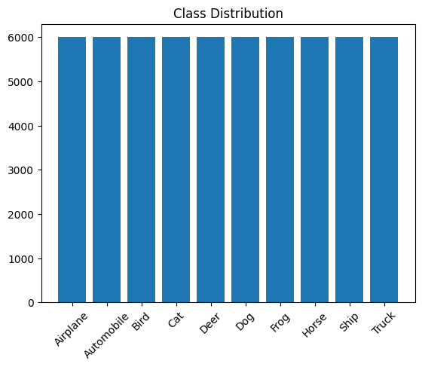
CIFAR-10 Dataset Overview
60,000 RGB images (32x32 pixels).
10 balanced classes (e.g., airplane, car).
Data reduced to 400 entries due to resource constraints.

Slide 5
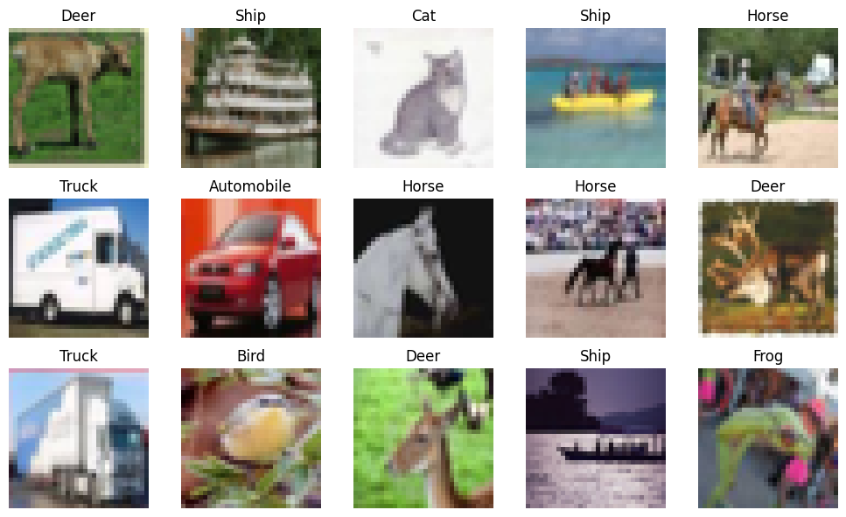
Key Insights from Dataset Analysis
High intra-class variability (e.g., different breeds of cats).
Low resolution adds challenges for feature extraction.
RGB channel analysis shows distinct color characteristics.

Slide 6
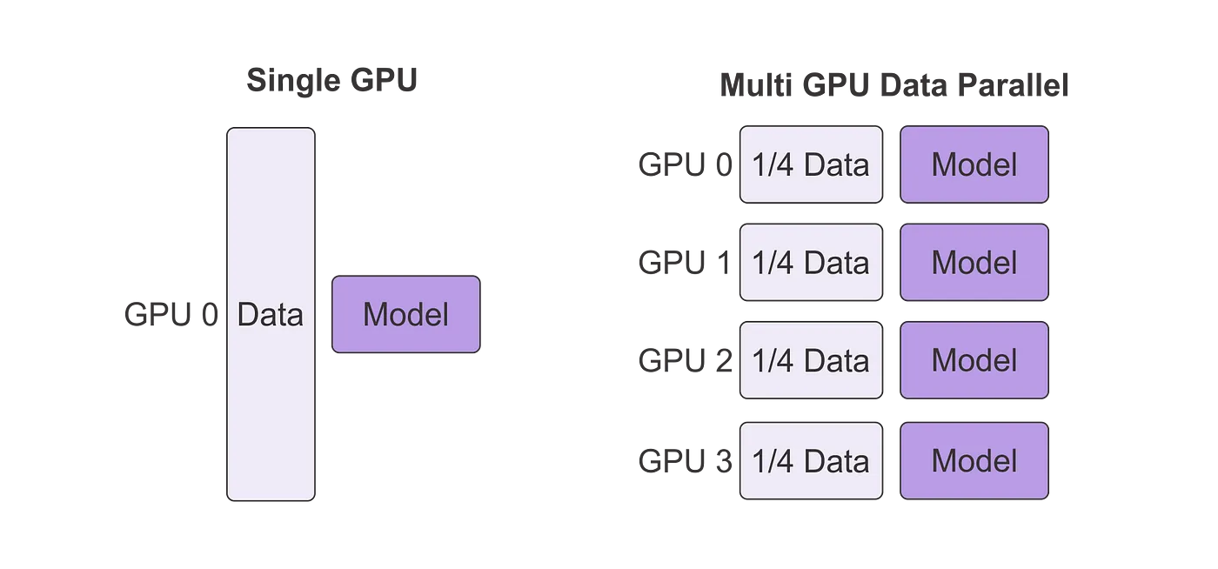
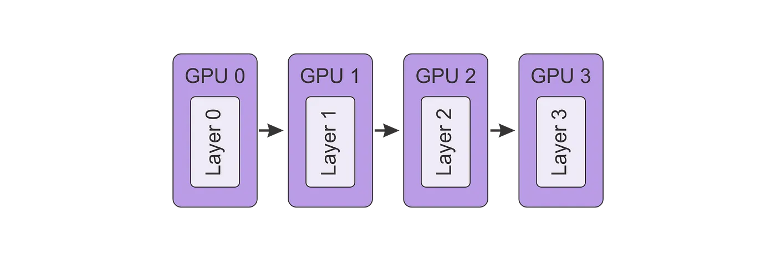
Hybrid Distributed Training Architecture
Combination of data and model parallelism.
Each CPU/GPU processes a subset of data.
Inter-device communication synchronizes gradients and model updates.

Slide 7
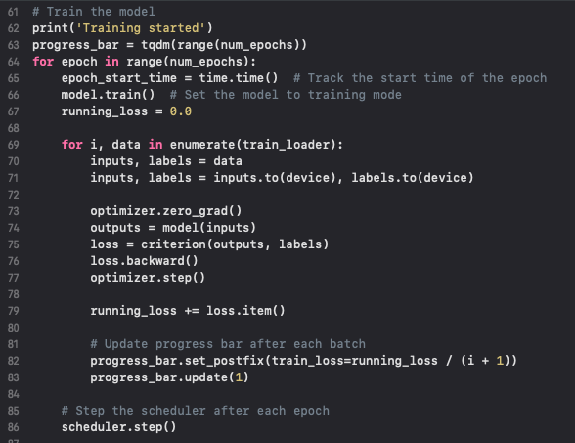
Single-node Code Highlights
Key components of single-node implementation.
Challenges in single-node training: longer training time and resource bottlenecks

Slide 8
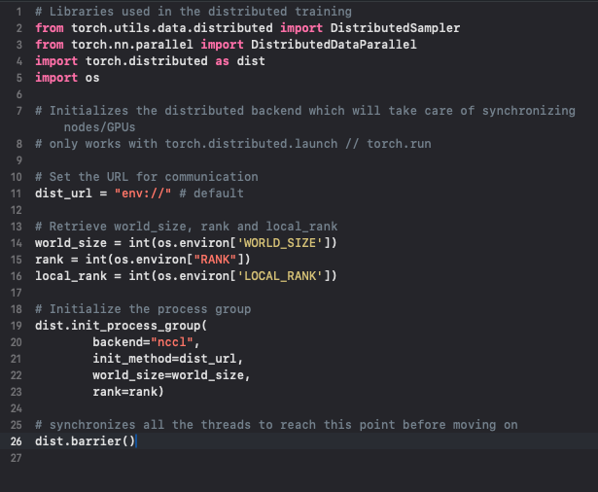
Distributed Parallel System (DDP) Code
Transition to Distributed Data Parallelism for multi-node training.
Efficient gradient synchronization between nodes.

Slide 9
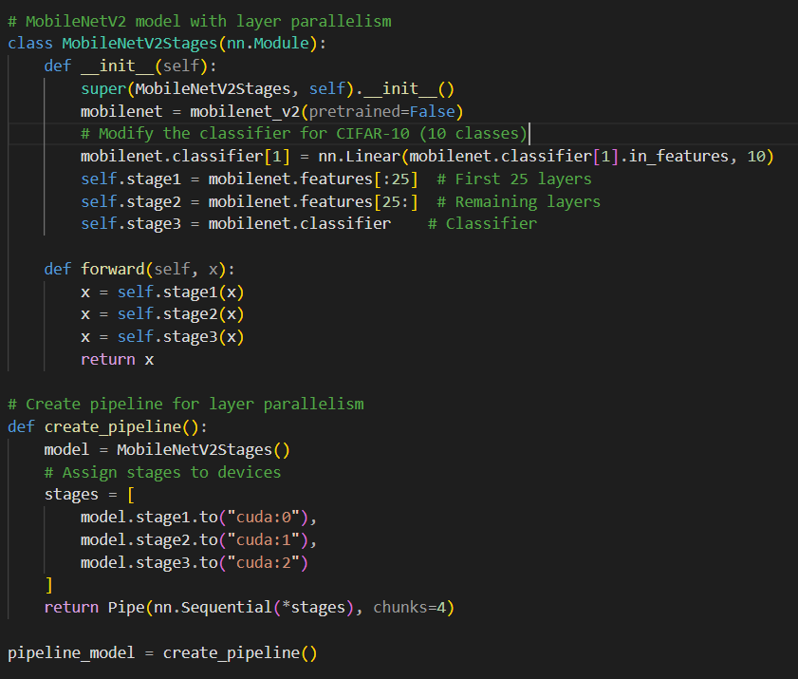
Distributed Parallel System (DDP) Code
Transition to Distributed Model Parallelism for multi-node training.
Efficient gradient distribution through multiple instances/nodes

Slide 10
Performance Results
Dataset run successfully on CPUs using DDP + DMP.
Achieved 80% better efficiency compared to single-node training.
Observed improvement in model convergence speed.

Slide 11
Project Limitations
Limited to CPUs due to resource constraints.
Dataset reduced to 20% entries for faster execution.
Unable to explore metrics like efficiency drop off due to n nodes, since latency will increase as nodes increase.
Unable to explore matices like virtual memory distribution and effectiveness due to limitation of using CPU only based nodes

Slide 12
Lessons and Future Scope
Importance of distributed systems for resource optimization.
Potential for extending the study with GPU and full datasets.
Opportunity to explore advanced metrics in future work.

Slide 13
Conclusion
DDP demonstrated significant efficiency gains over single-node training.
Hybrid approach shows promise for large-scale model training.
Further exploration can unlock more insights and optimizations.

Slide 14
Reference
Lerat, J., Mahmoudi, S. A., & Mahmoudi, S. (2022). Distributed Deep Learning: From Single-Node to Multi-Node architecture. Electronics, 11(10), 1525. https://doi.org/10.3390/electronics11101525
Lin, J., Li, X., & Pekhimenko, G. (2020). Multi-node BERT-pretraining: Cost-efficient approach. arXiv. https://arxiv.org/abs/2008.00177
Rajendran, R. M. (2024). Distributed computing for training large-scale AI models in .NET clusters. Journal of Computational Intelligence and Robotics, 3(4), 45–60. https://thesciencebrigade.com/jcir/article/view/138

Slide 15
Thank You!

